Slide 1


Slide 2
Slide for video

Slide 3

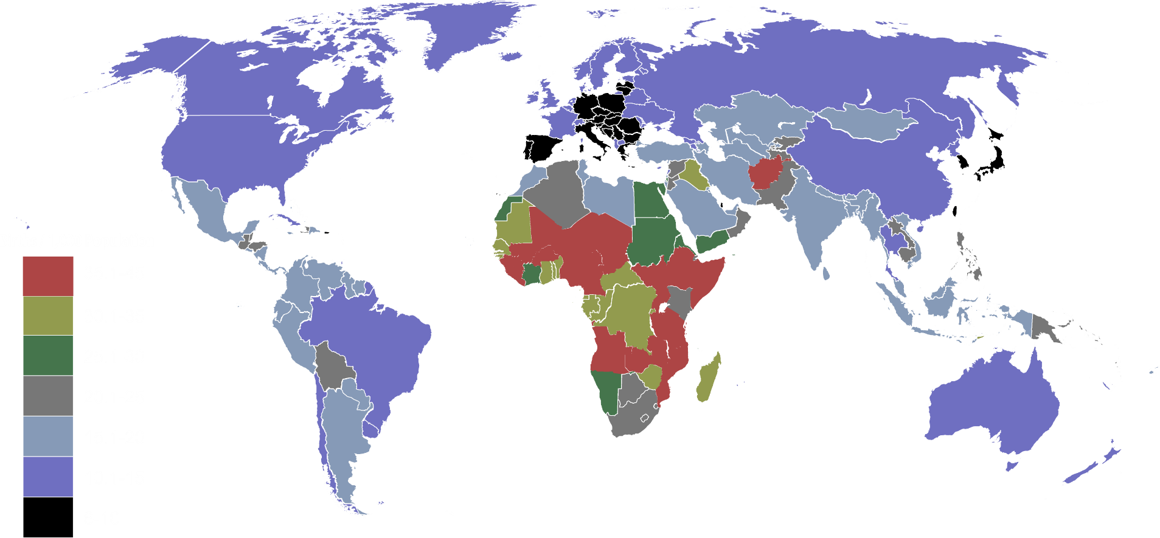
Countries by birth rate in 2017

Slide 4

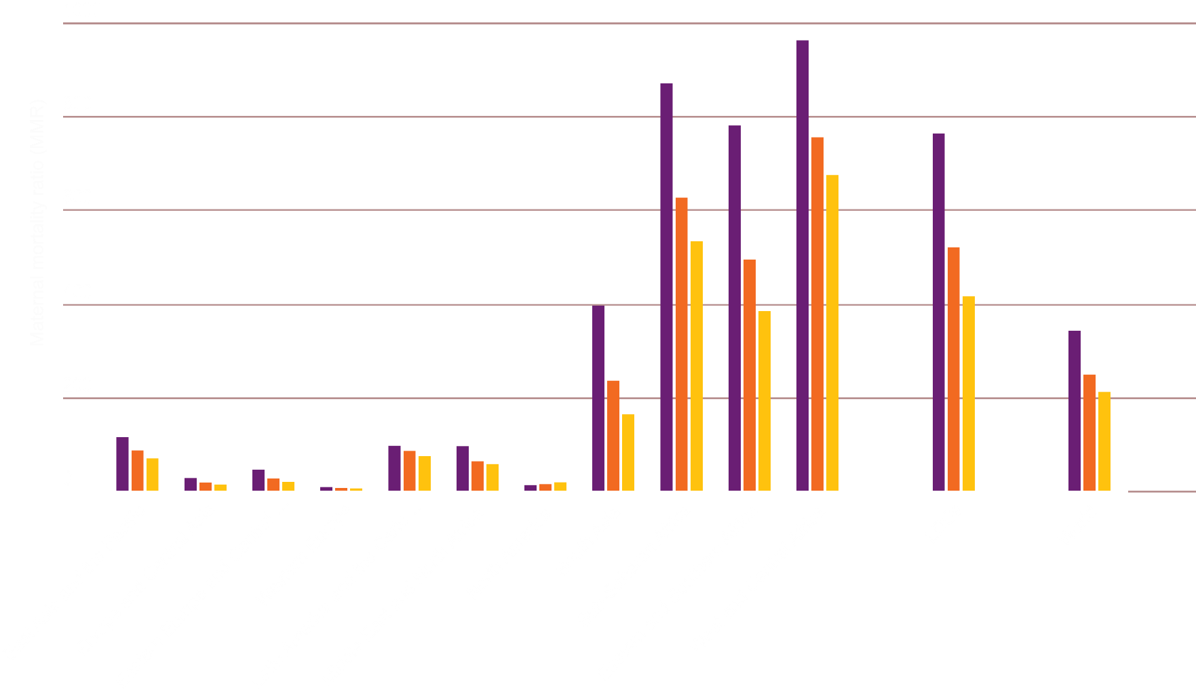
Maternal Mortality ratio
2000
2010
2017

Slide 5

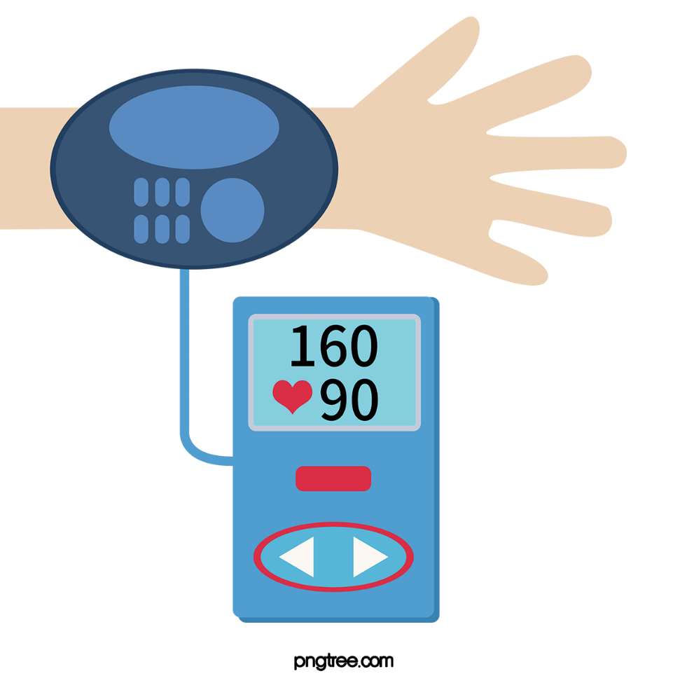
Problems
Scheduled Monitoring of body temperature, bpm and blood pressure could not be done.

Slide 6
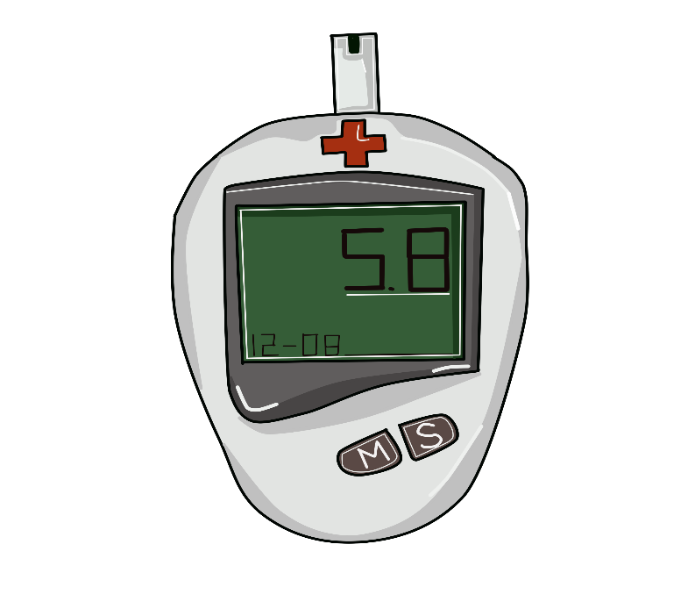
Lack of proper monitoring of UV index level can hamper a pregnant woman and her child.

Slide 7

Medicine specially anti biotics need to take in proper time. If it does not than it could develop anti resistant for a disease.

Slide 8

Proper nutrition taking is a must for pregnant woman and her child's health.

Slide 9





Steps we need to take
Continuous monitoring of temperature
Scheduled monitoring of UV ray index
Scheduled monitoring of bpm and blood pressure
Maintaining schedule for medicine
Emergency service

Slide 10


Slide 11
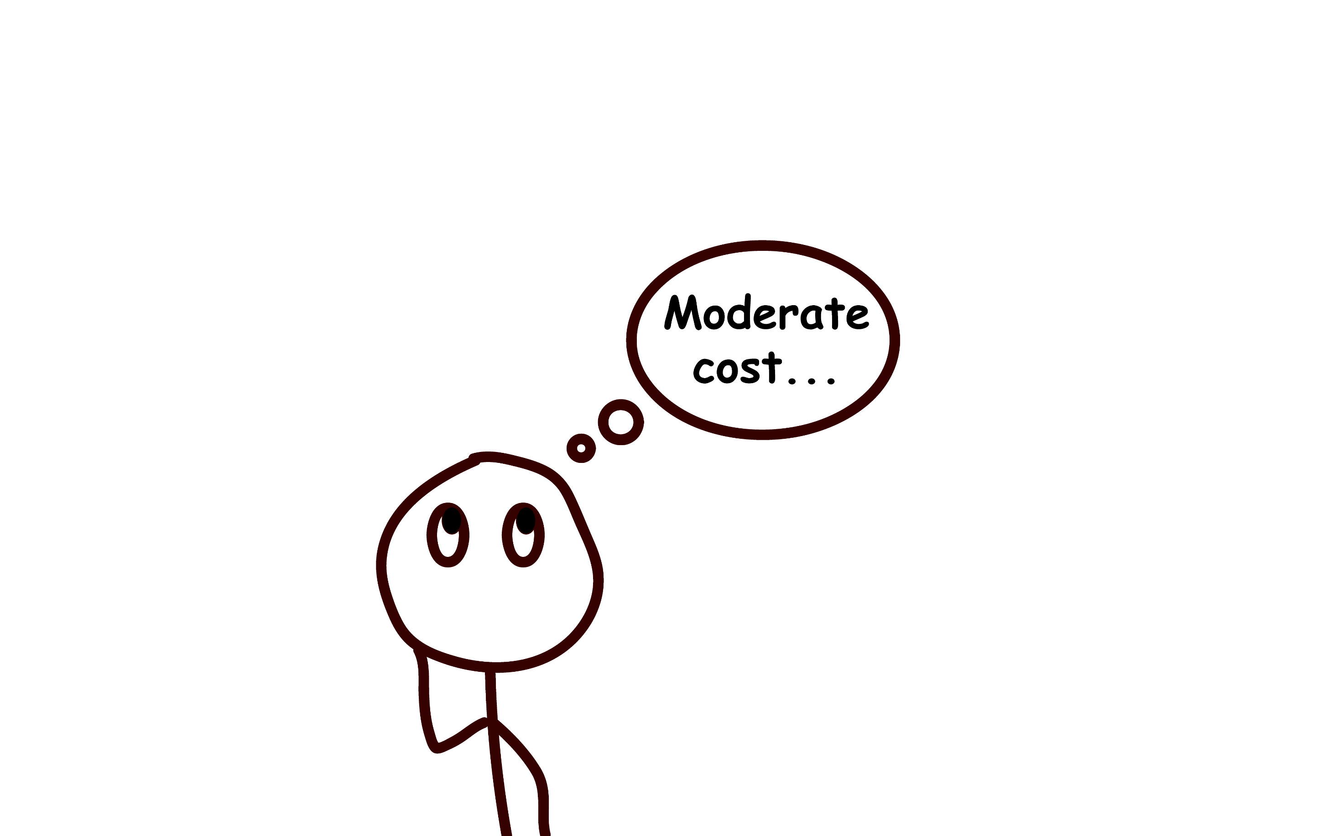


Slide 12
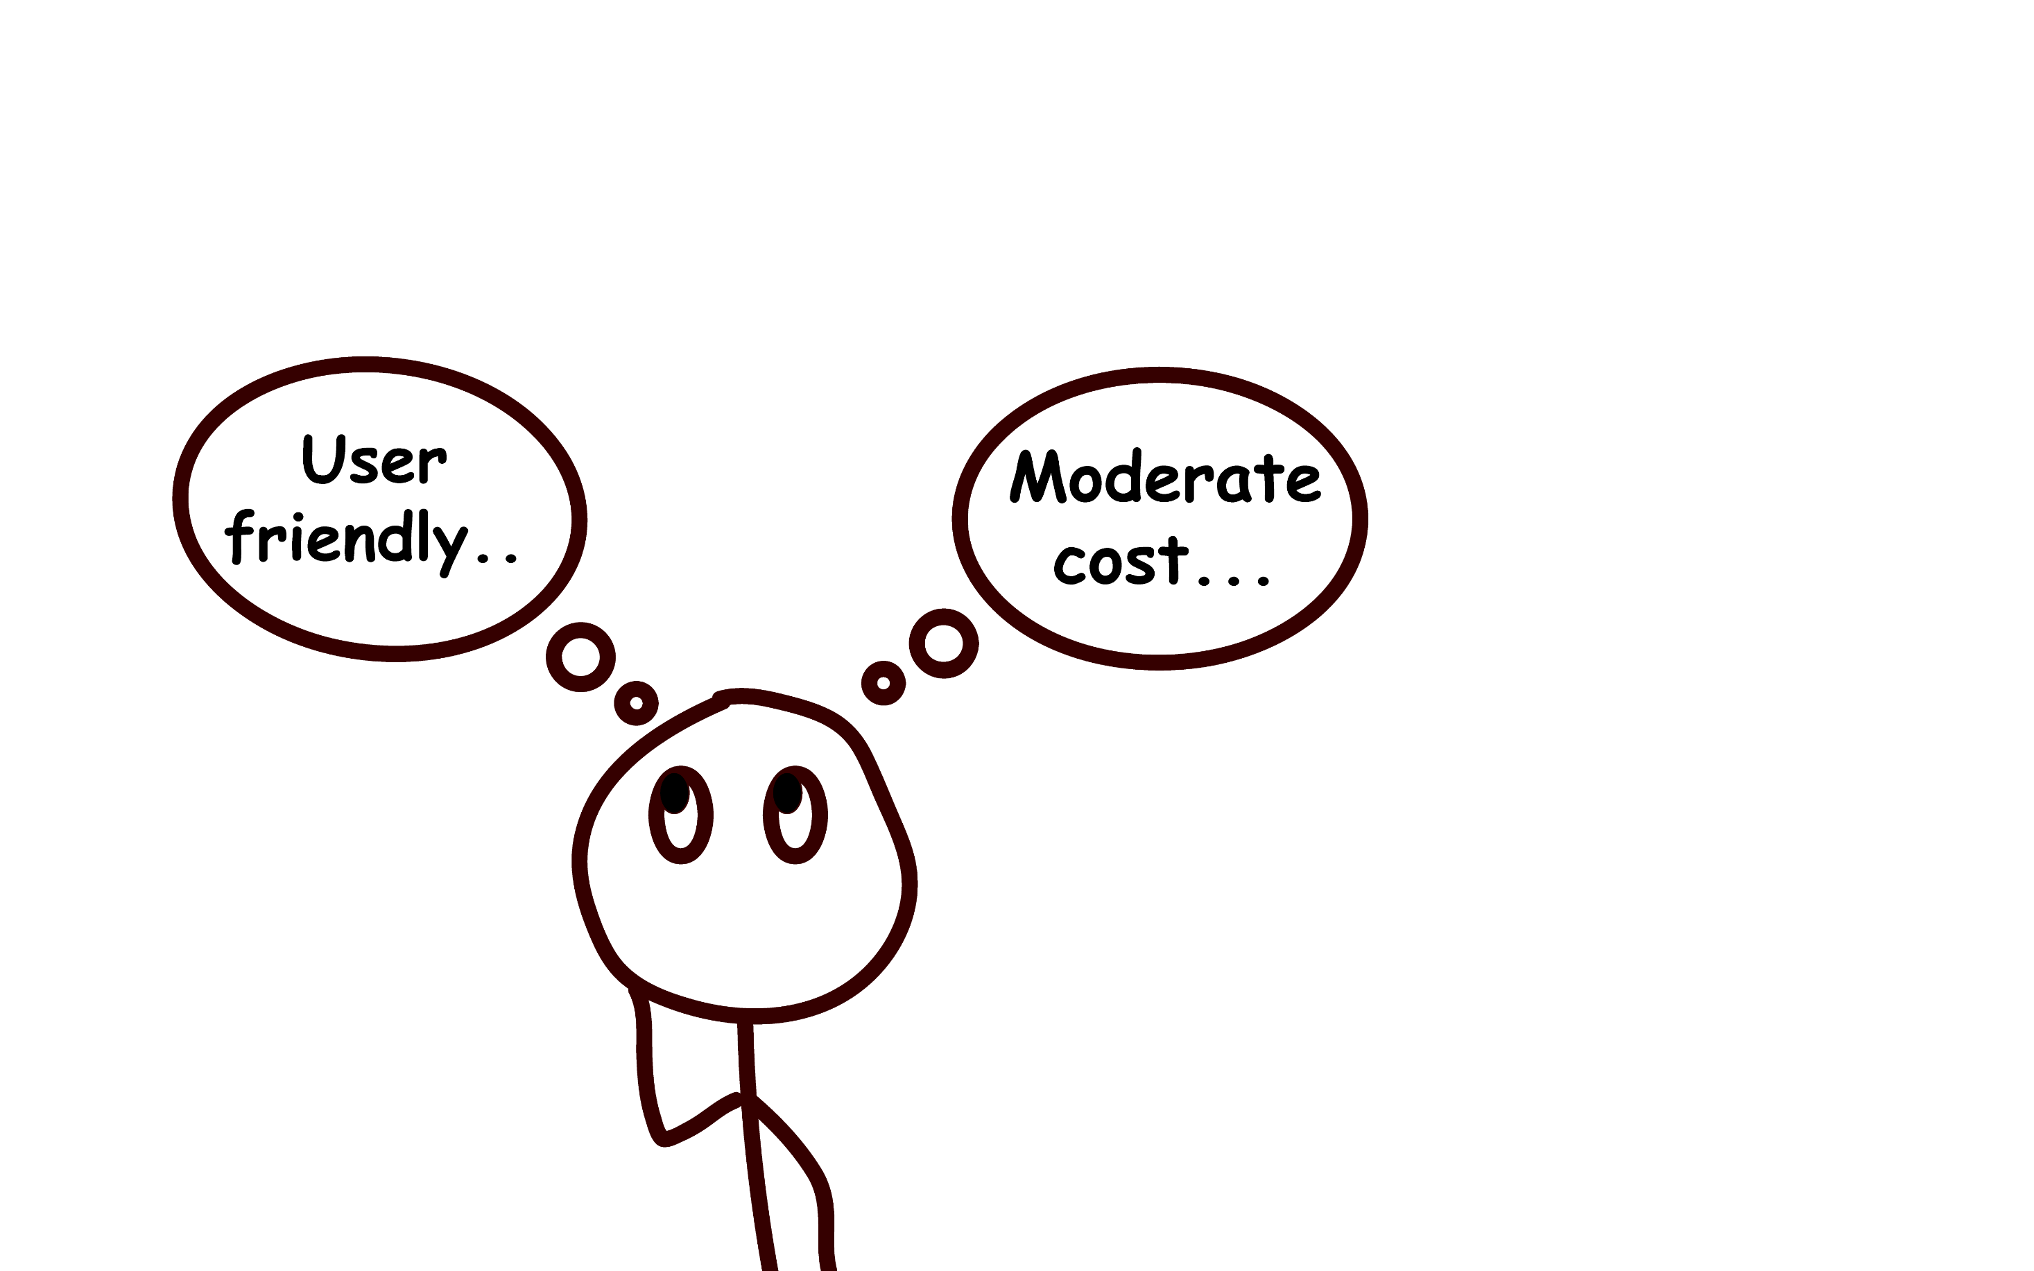


Slide 13
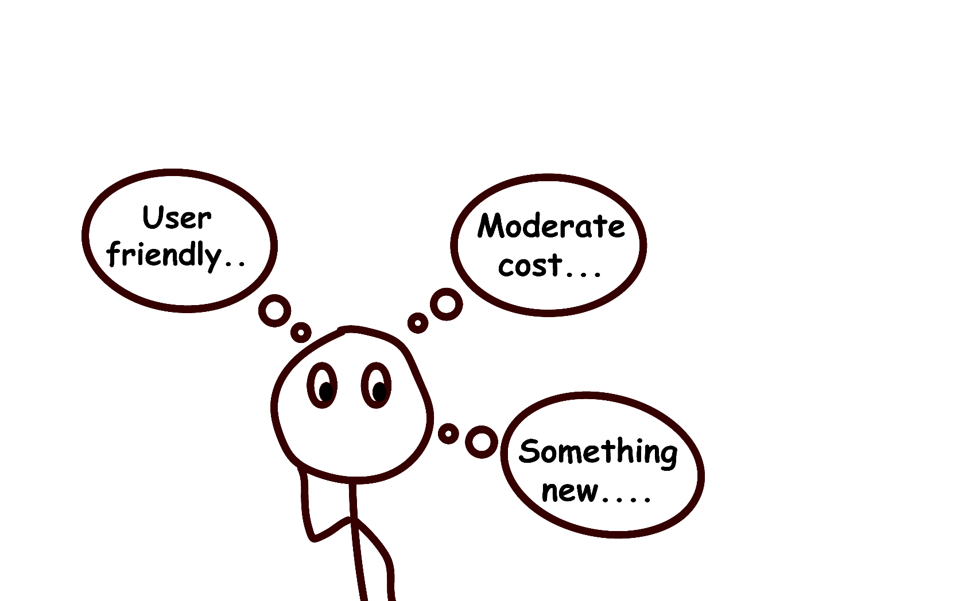


Slide 14

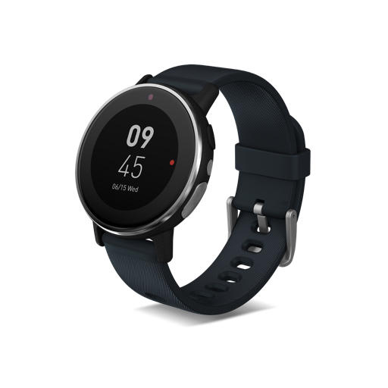
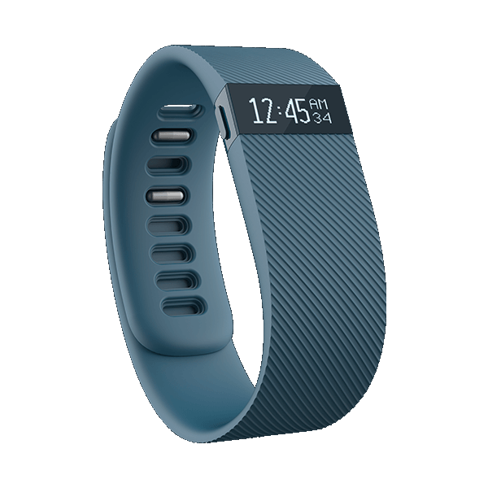
Trends
Fitbit Charge
Price: 23,000 BDT
Acer Leap Ware
Price: 16,200 BDT

Slide 15
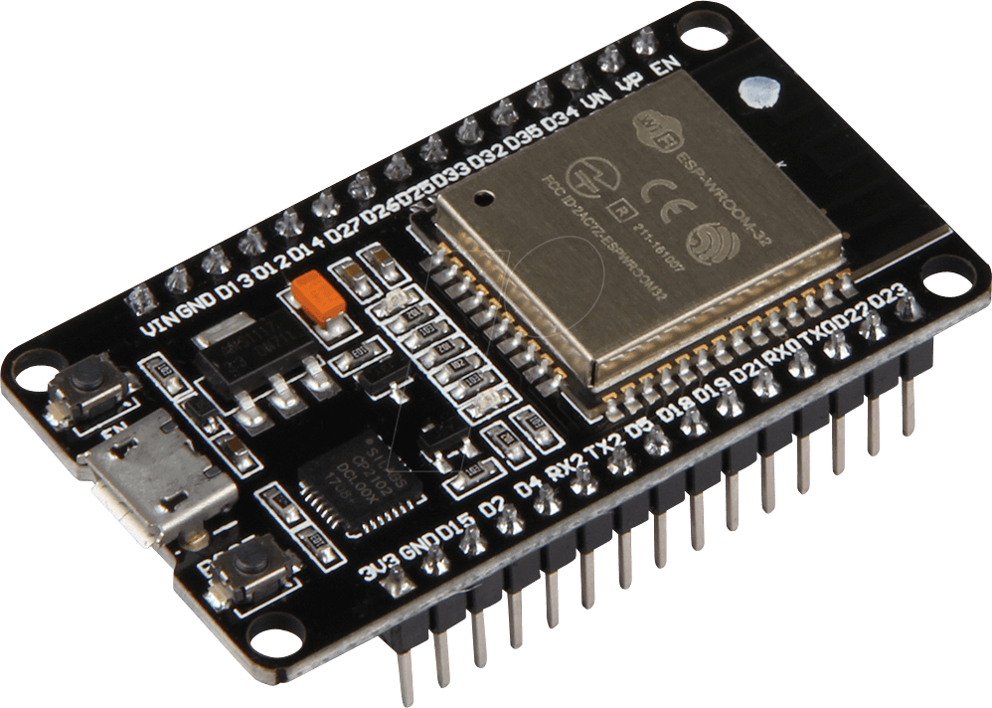
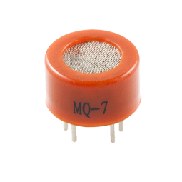
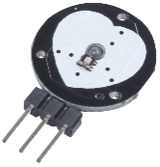
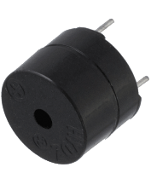
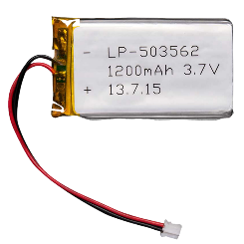
Components
ESP 32
Co sensor
Pulse sensor
Buzzer
Lipo 1200 mAh

Slide 16
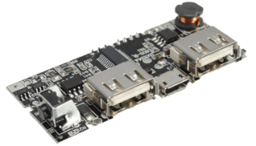
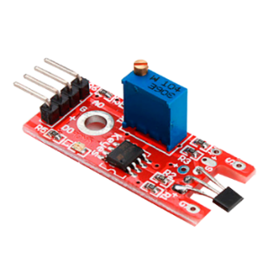
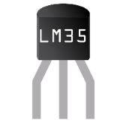

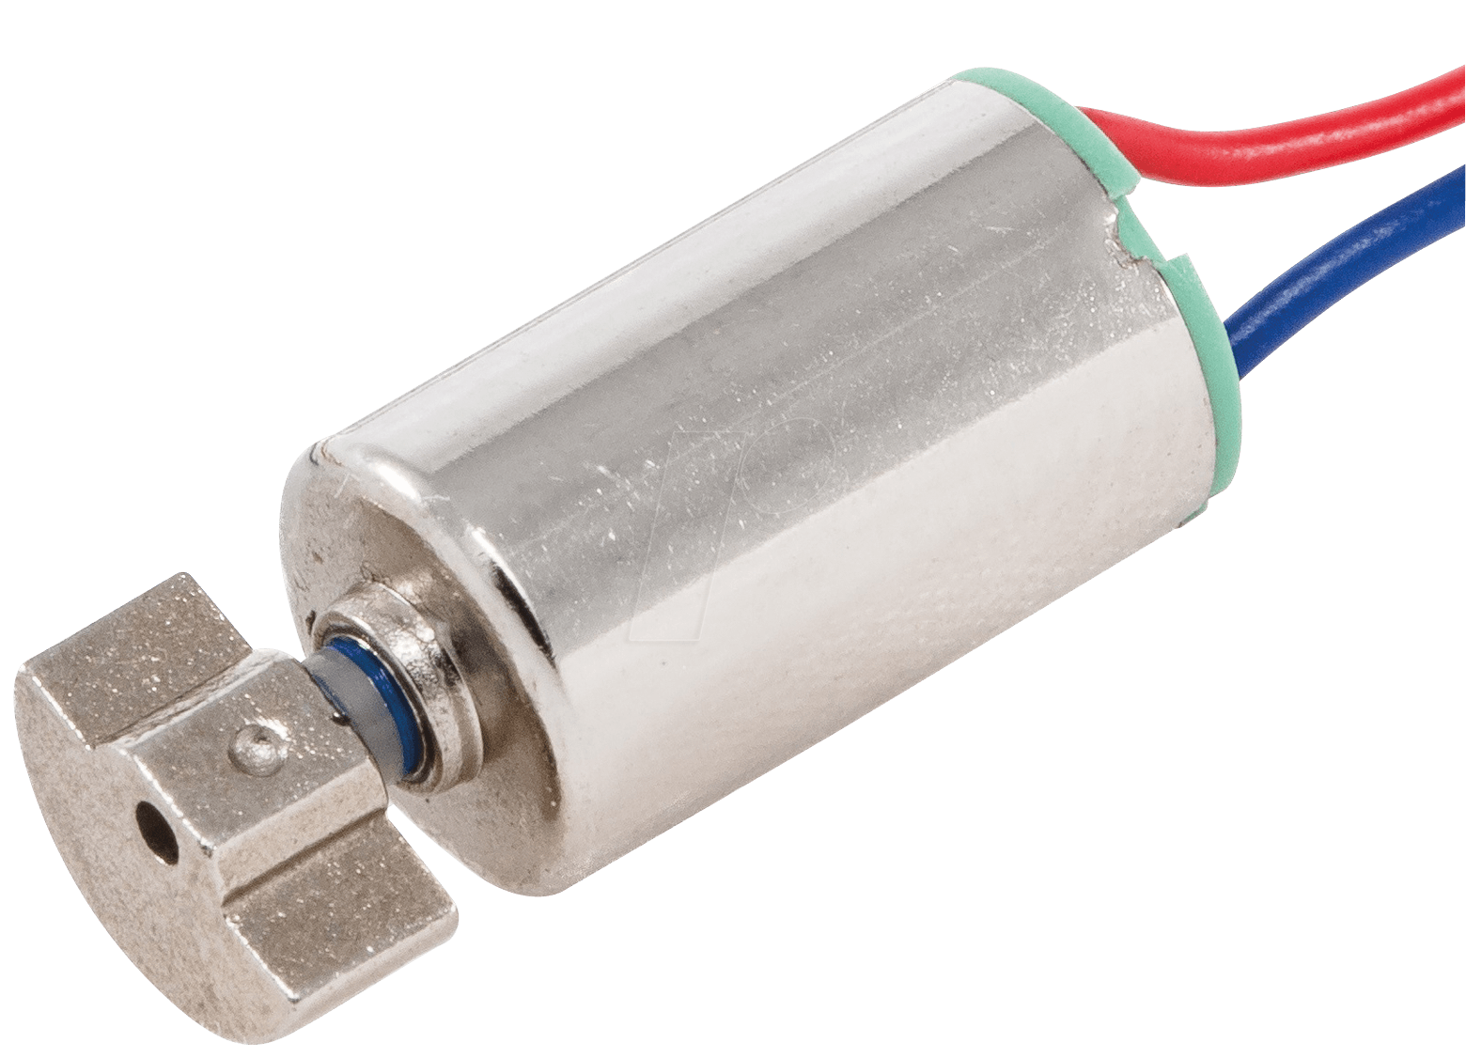

Integrated power bank circuit
Internally built in hall effect sensor
Temperature sensor LM35
Built in Bluetooth
Vibrator
Special switches

Slide 17


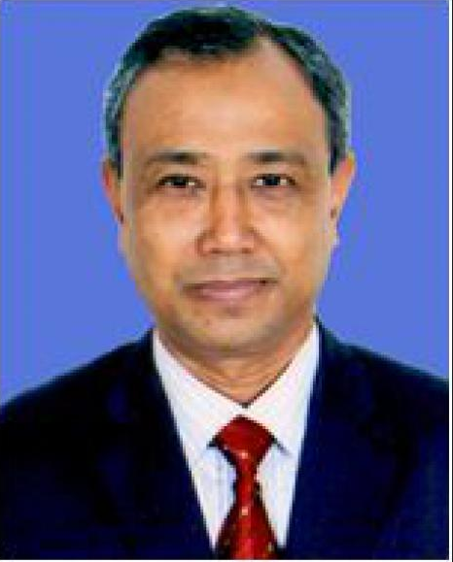
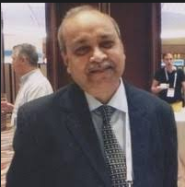

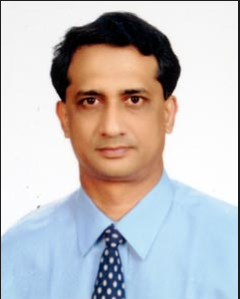
Name : Dr. Md. Al-Amin Mridha
Designation : Consultant
Name : Dr. Md. Atiqul Islam
Designation : Consultant
Name : Dr. Bodhrun Naher
Designation : Consultant
Name : Professor Dr. Afiqul Islam
Designation : Professor
Name : Professor Dr. Selim Shakur
Designation : Consultant & Head of Department of Pediatrics
Name : Professor Dr. Md. Abid Hossain
Designation : Professor, Department of Pediatrics

Slide 18


Slide 19

Balanced scorecard slide 5
Cost Breakdown
COMPONENTS
BDT
USD
RUPEES
TOTALS : 784/-
320/- 3.78 $ INR 269
ESP 32
65/- 0.77 $ INR 54.69
MQ-7
90/- 1.06 $ INR 75.72
PULSE SENSOR
250/- 2.95 $ INR 210.33
LIPO BATTERY 3.7V
RECHARGEABLE CKT
20/- 0.24$ INR 16.83
BUZZER & VIBRATOR
39/- 0.47$ INR 33.65

